Slide 1

Water Purifier Data Analysis
Web scraping with Data Visualizations
Website: www.flipkart.com/water-purifiers/ pr?sid=abm%2Ci45&page=1
Problem Statement:
Extracting the water purifiers data and identifying the different varietals of water purifiers produced by different companies.
By
R.Harish
B.Dinesh
(BATCH NO-247)

Slide 2
What is Web Scraping?
Web scraping refers to the extraction of web data on to a format that is more useful for the user.
Web scraping can help you extract any kind of data that you want. You would then be able to retrieve, analyze and use the data the way you want.
So, web scraping simplifies the process of extracting data, speeds it up by automating it and creates easy access to the scrapped data by providing it in a CSV format.

Slide 3
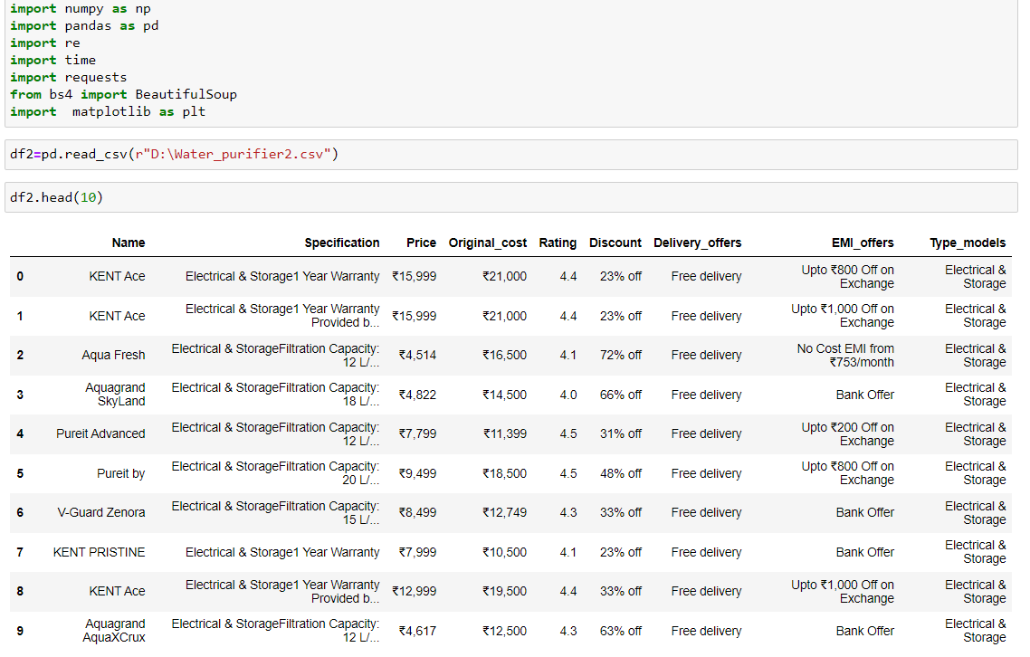
Data Extaction
Importing all the necessary modules for extracting data and analyzing it.

Slide 4
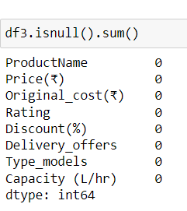
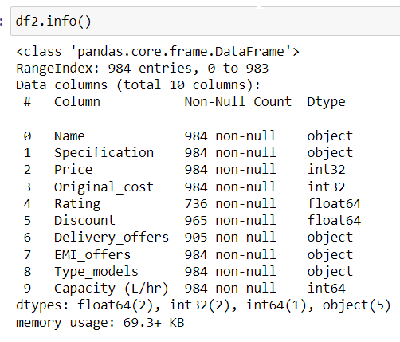
Data Extaction

Slide 5
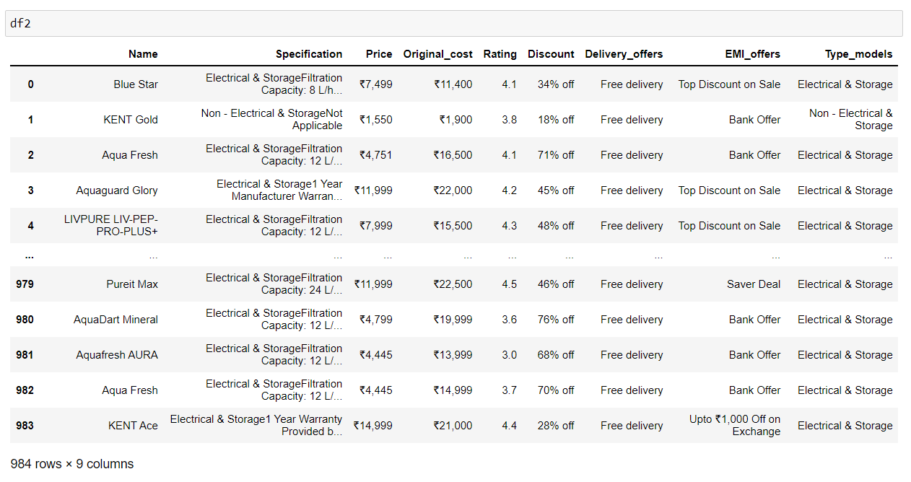

Slide 6
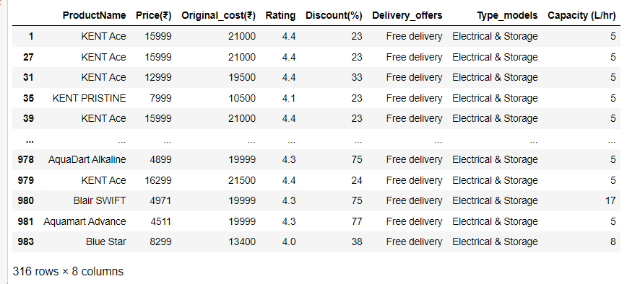
Data cleaning

Slide 7
Data Visualization
Univariate Analysis:
It is used to summarize only one variable at a time.
Bivariate Analysis:
Bivariate statistics compare two variables and determine relation between them.
Multivariate Analysis:
Multivariate statistics compare more than two variables.

Slide 8
User Requirements
Only Electrical & Storage type
Water purifier under Rs.6000
Storage capacity of 5L

Slide 9
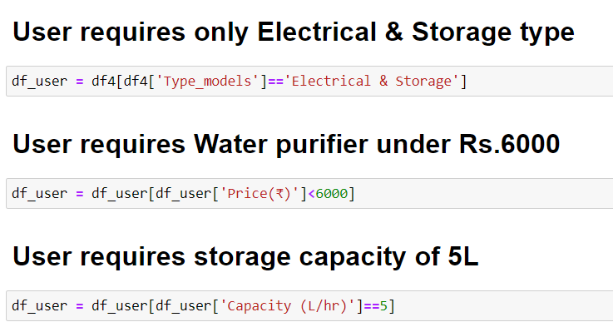

Slide 10
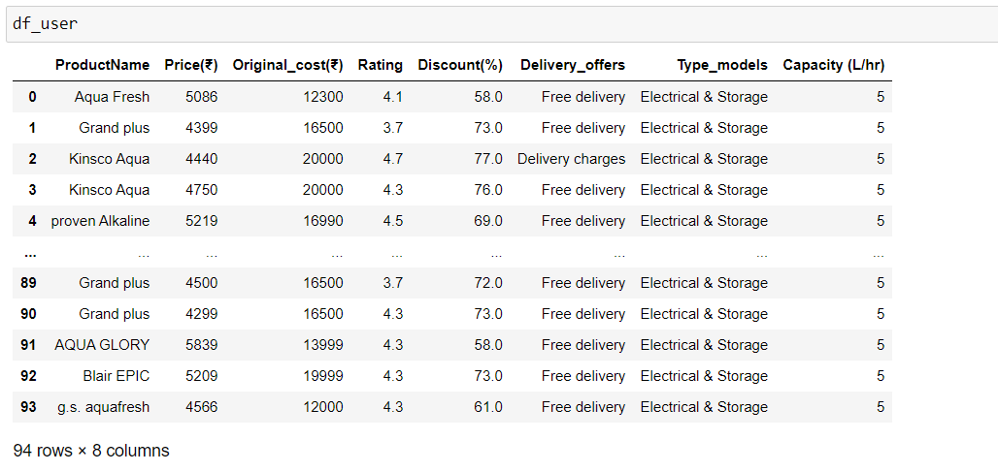

Slide 11
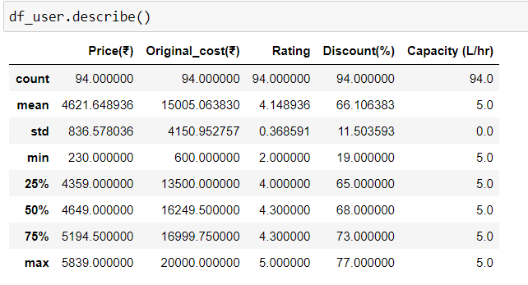

Slide 12
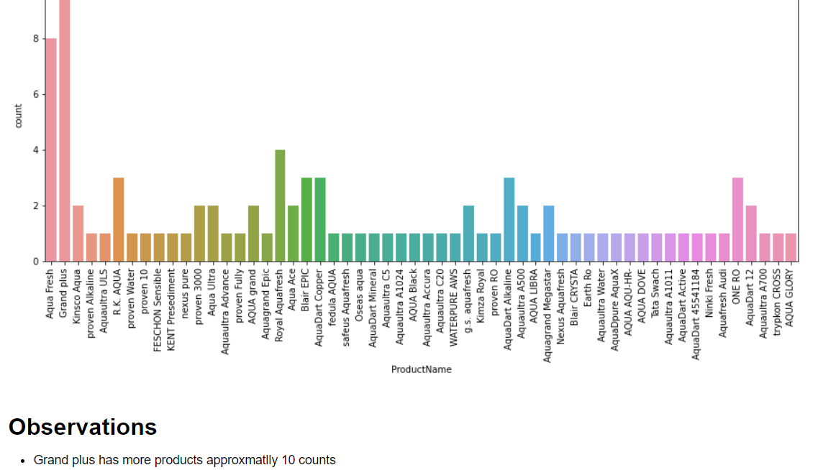

Slide 13
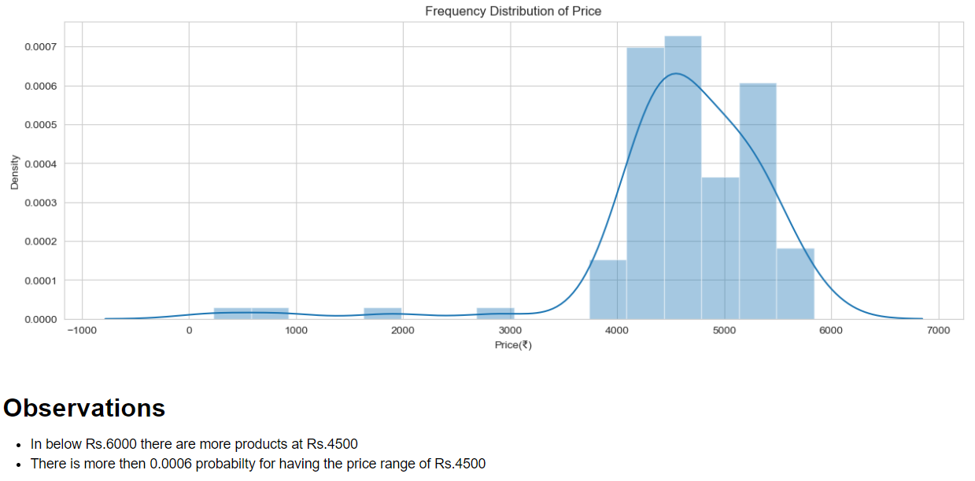

Slide 14
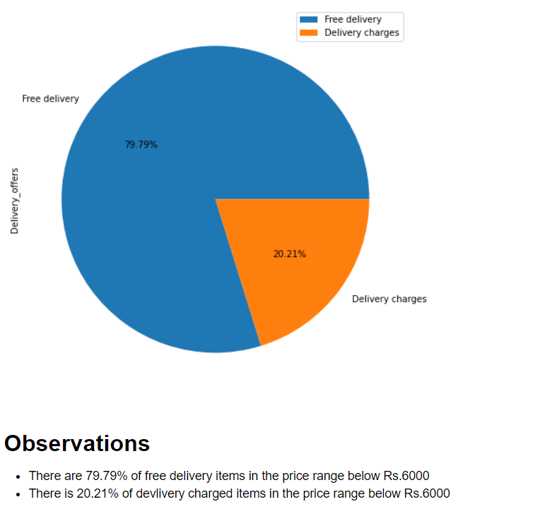

Slide 15
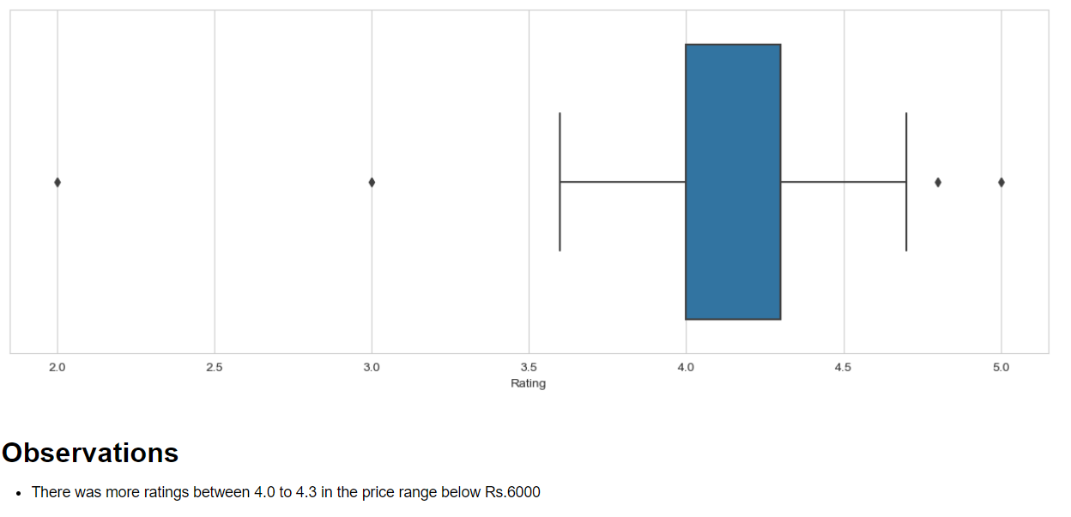

Slide 16
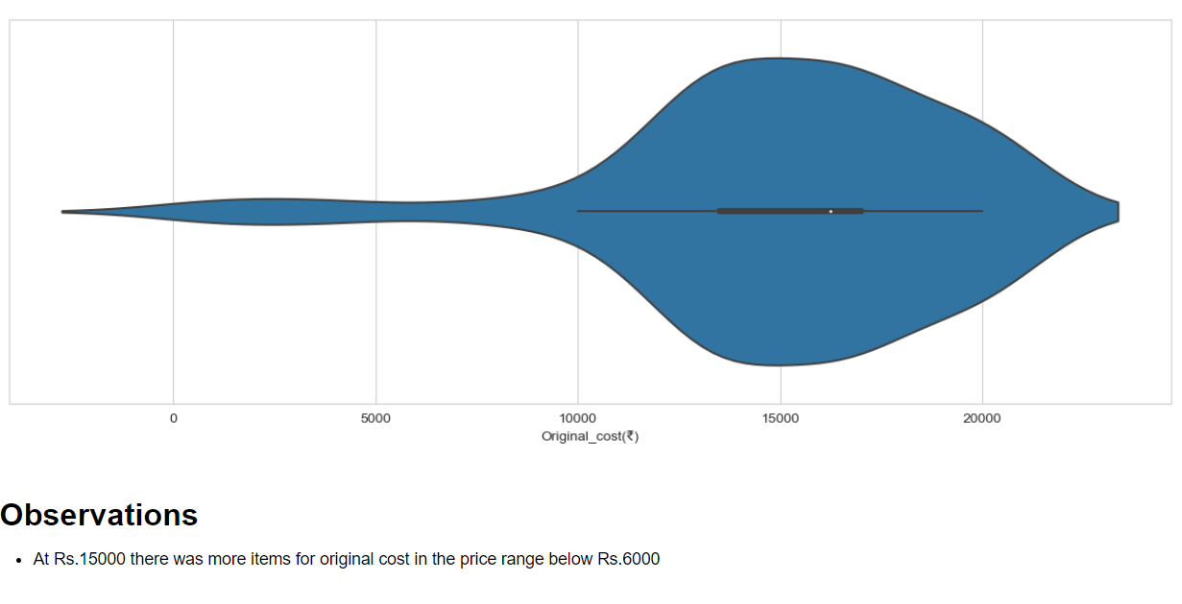

Slide 17
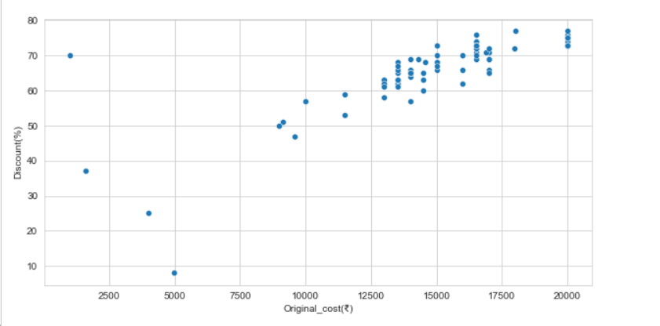
Observations
For price range between Rs.12500-Rs.20000 having more discount from 60% to above 70%.

Slide 18
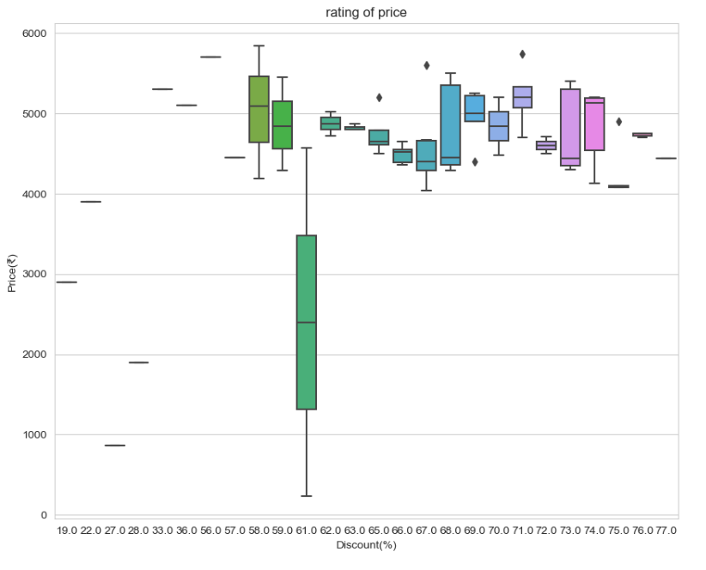

Slide 19
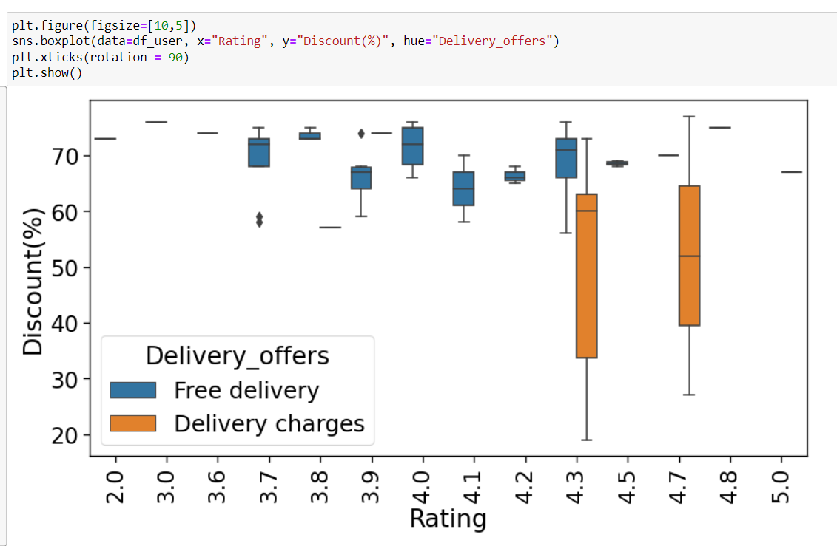
observations
In between ratings of 4.3 to 4.7 the delivery charges are more
The 60-70% of discount water purifiers delivery is free

Slide 20
Summary
The user requires a 5L Electrical storage water purifier under Rs. 6000
The user can find more options of products around Rs. 4500.
Average Ratings for the products below Rs. 6000 is between 4.0 to 4.3
Products with rating of 4.3 and 4.7 have a have the highest delivery charges and lowest discounts.
Products with lower ratings for the products are having more discounts.

Slide 21

THANK YOU

